Slide 1
WEB HONEYPOT: DETECTING AND ANALYZING MALICIOUS WEB
PRESENTED BY,
SUYASH KHARE
AARTI BAGDE
UJJWAL CHOUDHARY
CIYA KABIRAJ

Slide 2
CONTENTS
Problem Statement
Objective
Technology Stack
Methodology
Expected Outcomes
Demo

Slide 3
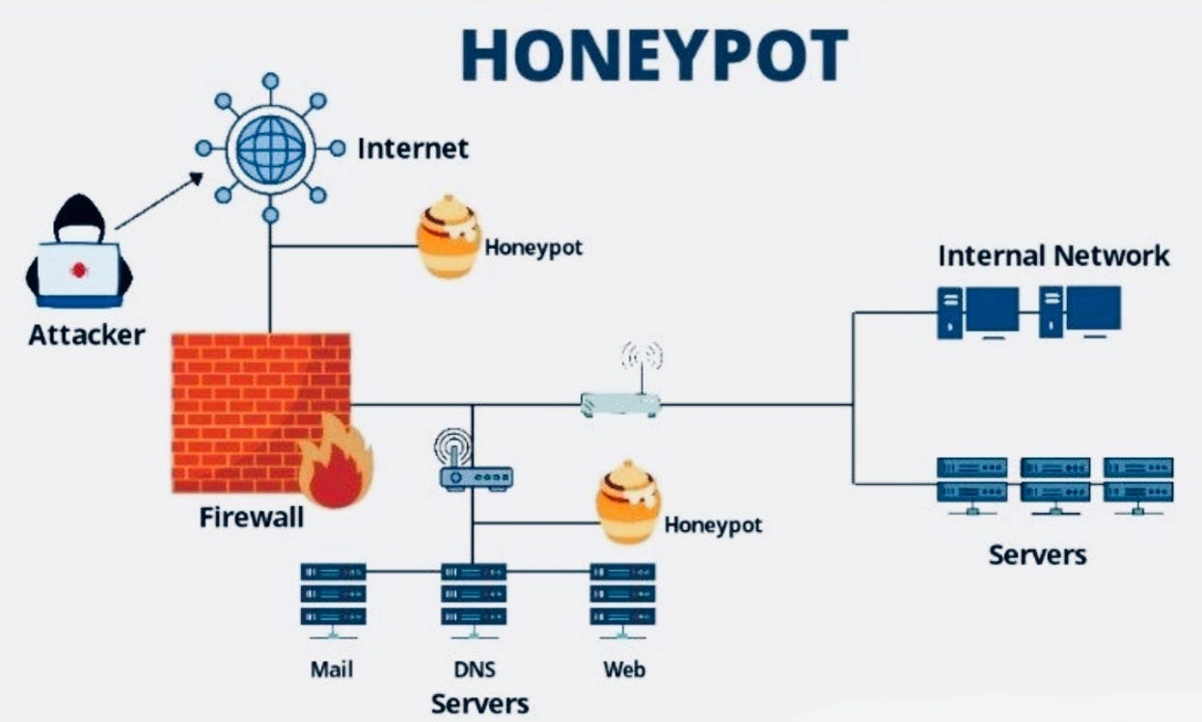
Problem Statement
What is the issue?
- Cyberattacks on web applications are increasing exponentially (e.G., SQL injection, XSS, brute force attacks).
- Organizations lack proactive measures to detect and analyze malicious activities in real-time.
- There is a need for a system that can lure attackers, study their behavior, and provide actionable insights to improve cybersecurity defenses.

Slide 4
Objective - Goal of the Project
- To develop a web-based honeypot that mimics a vulnerable website to attract attackers.
- To monitor, log, and analyze malicious activities for research and security enhancement.
- To provide insights into attack patterns and improve cybersecurity defenses.

Slide 5
Technology Stack - Tools & Frameworks
- Frontend : HTML, CSS (to create a realistic-looking website).
- Backend : Python (for server-side scripting).
- Database : MySQL (to store logs and attack data).
- Honeypot Script : Custom Python scripts to simulate vulnerabilities.
- Deployment : Local Host

Slide 6
Methodology
Step 1 : Design a realistic-looking website with intentional vulnerabilities (e.g., fake login pages, forms).
Step 2 : Implement the honeypot script to detect and log malicious activities (e.g., SQL injection attempts, XSS payloads).
Step 3 : Deploy the website on local host server and monitor traffic.
Step 4 : Analyze logs to identify attack patterns and behaviors.
- Step 5 : Generate reports and insights for improving cybersecurity measures.

Slide 7
Expected Outcomes
What We Aim to Achieve ?
- A fully functional web honeypot that attracts and logs malicious traffic.
- Detailed analysis of attack patterns (e.g., common vulnerabilities exploited).
- Insights into attacker behavior and tools used.
- A foundation for improving real-world cybersecurity defenses.

Slide 8
Q&A
Questions?
- Open the floor for questions and discussions

Slide 9
THANK
YOU

